Slide 1

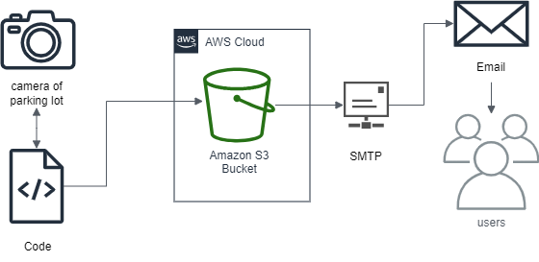
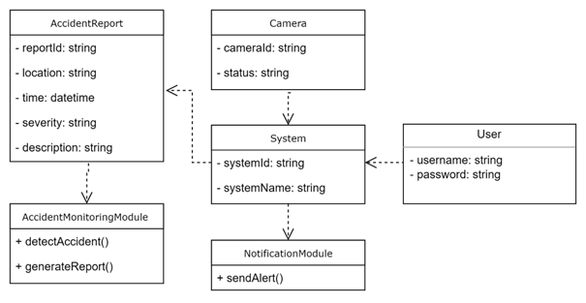
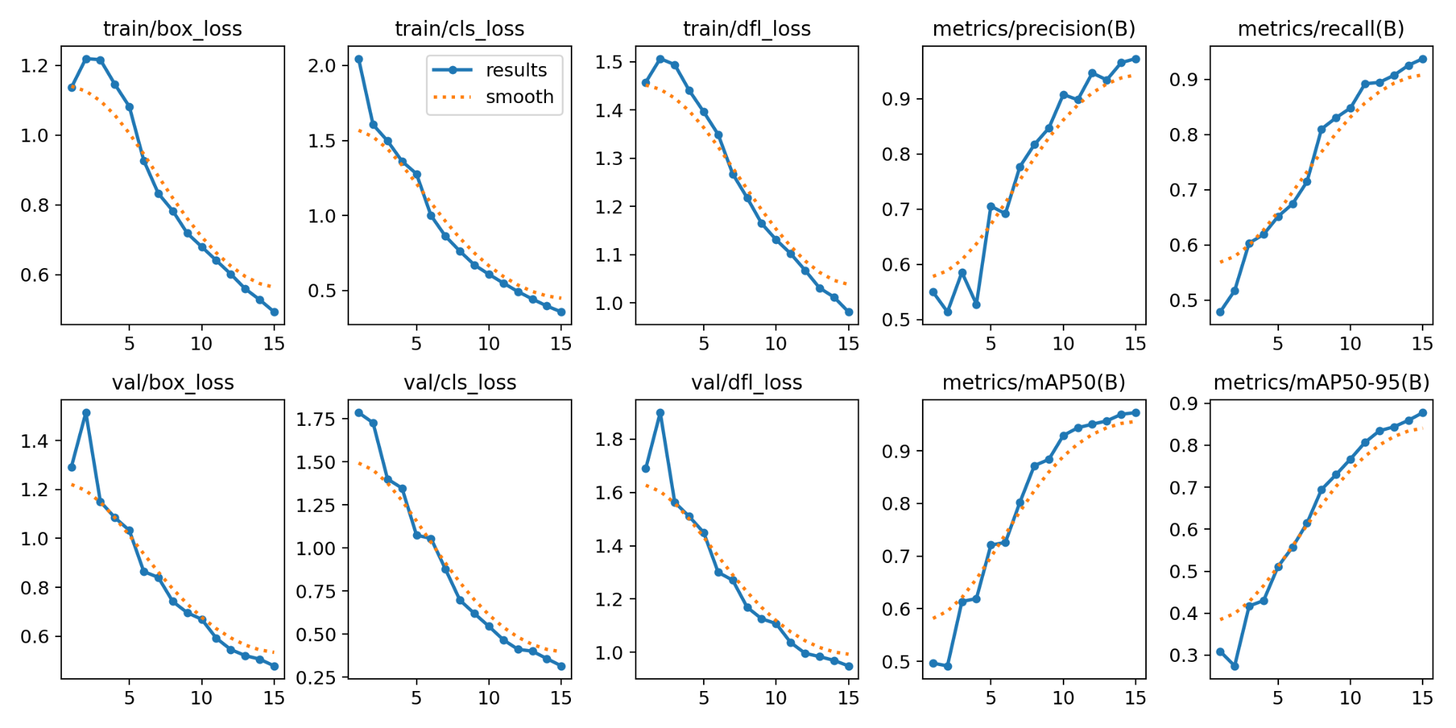
College of Information Technology - Department of Computer Science
Roadeye
Mohamed Rihal, 20192767
Mohamed Yaqoob Abdulla, 20173577
Khalid Hani Salim, 20199728
Supervised By: Dr. TAHER SALEH KHAID HOMEED
Abstract
Objectives
RoadEye is an innovative system designed to monitor and analyze accidents occurring in the parking lot by leveraging machine learning techniques and connecting to cameras. This project utilizes the Python programming language to develop a robust and efficient system capable of detecting and reporting accidents in real time. By integrating with existing camera infrastructure, RoadEye aims to enhance road safety by providing real-time notifications through E-mail and valuable insights to relevant authorities and emergency services.
Using state-of-the-art machine learning algorithms, RoadEye processes the live video feeds from cameras to identify potential accidents. The system employs computer vision techniques to detect and track cars in real time. By analyzing the behavior and interactions of these objects, RoadEye can accurately identify and classify accidents, including collisions, near misses, and other hazardous incidents.
Once an accident is detected, RoadEye promptly generates detailed incident reports, including the location, time, and type of accident. These reports are automatically forwarded to the appropriate authorities, enabling them to quickly respond and dispatch emergency services to the scene. Additionally, RoadEye provides statistical analysis and visualizations of accident data to aid in identifying accident-prone areas, evaluating road safety measures, and making informed decisions about infrastructure improvements.
Enhance road safety by accurately detecting and reporting accidents in real time.
Reduce accident response times by promptly notifying relevant authorities and emergency services.
Leverage machine learning and computer vision techniques to improve accident detection and classification accuracy.
Create safer and more efficient road systems by leveraging technology for accident prevention and management.
Methods/Diagrams/Figures
Results
Conclusion & Future work
A strong and effective system has been created because of the integration of YOLOv8 for real-time object detection, the construction of a Python-based backend, and the deployment on AWS infrastructure. We have promoted smooth communication and event reporting by utilizing communication platforms like SMTP and Google Forms, which has strengthened our dedication to the security and welfare of the university community. Significant enhancements are planned for the Road Eye system in the future to improve both its functionality and user experience. The main goal will be to provide a user-friendly web interface that makes it easier for users to engage with incident reports, live camera feeds, and associated data.

